Slide 1

Sentiment Analysis and Fake News Detector
TEAM MEMBERS: Guide: Prof. Sujit Badodia
Manas Joshi Co-Guide: Prof. Jayesh Surana
Bhavesh Somnani
Ismith Ghelot
Kapil Odiya

Slide 2
Contents
Use case diagram
Detailed Class/object diagram
Sequence Diagram
Collaboration Diagram
Test plans/Test Cases
50 % implementation

Slide 3
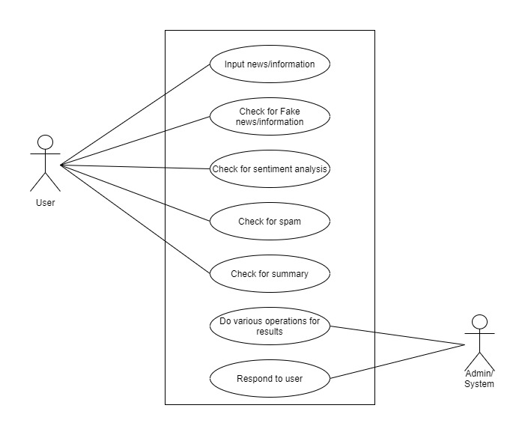
Use case diagram

Slide 4
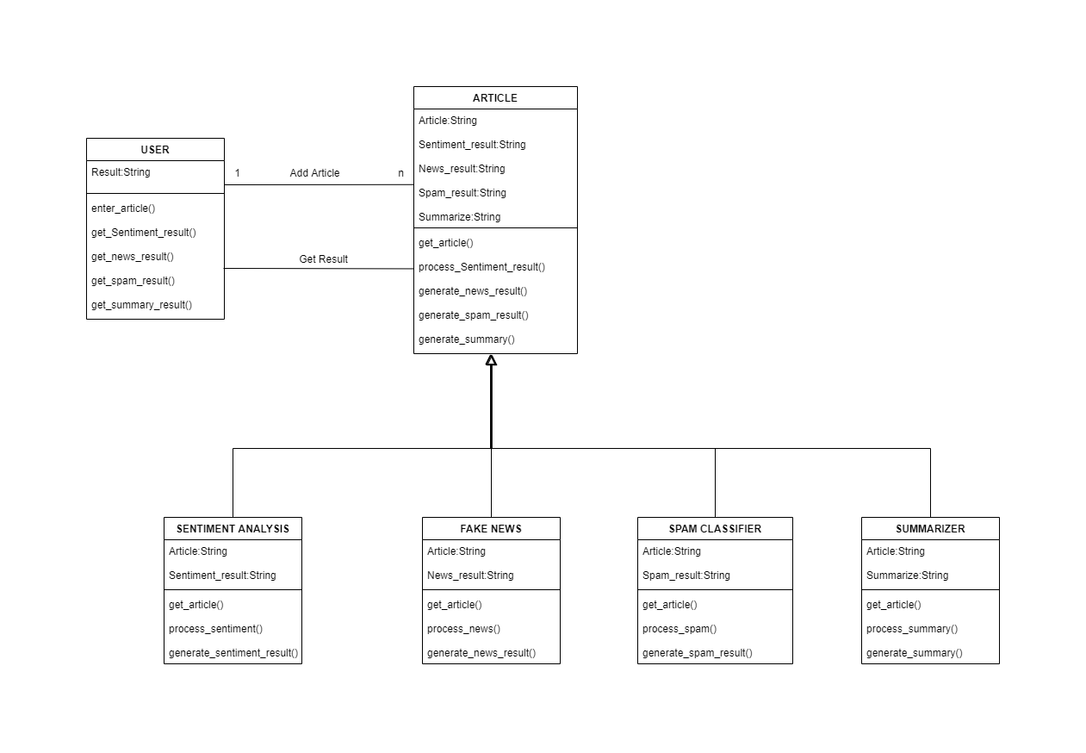
Detailed Class diagram

Slide 5
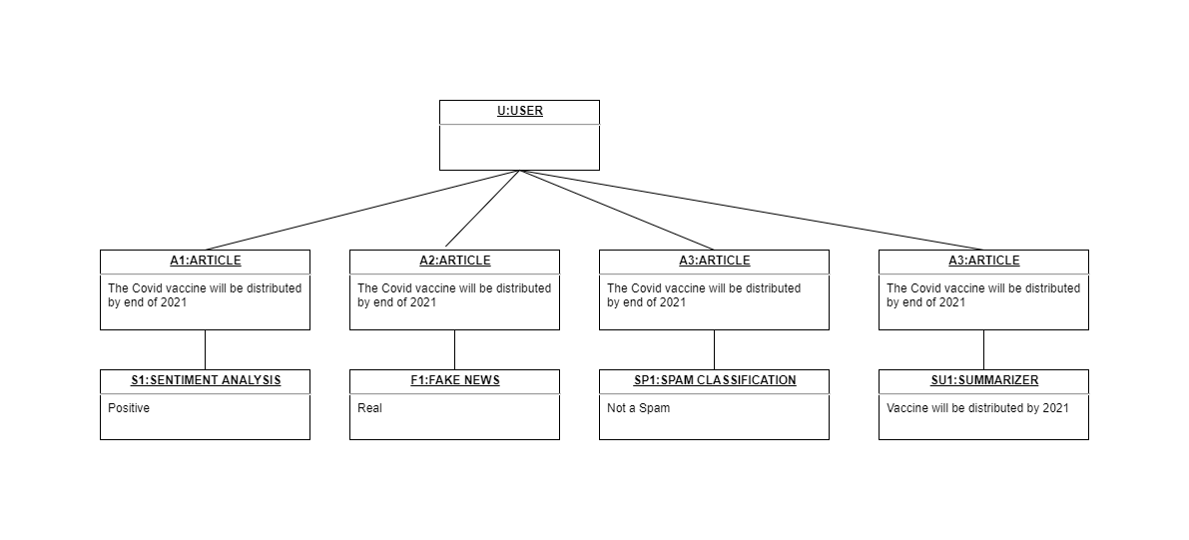
Detailed object diagram

Slide 6
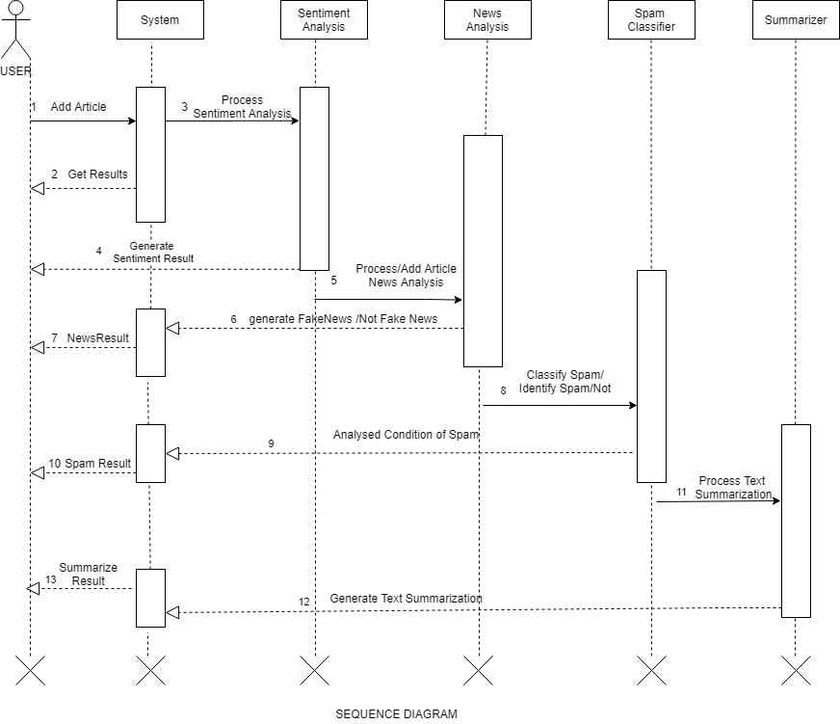
Sequence Diagram

Slide 7
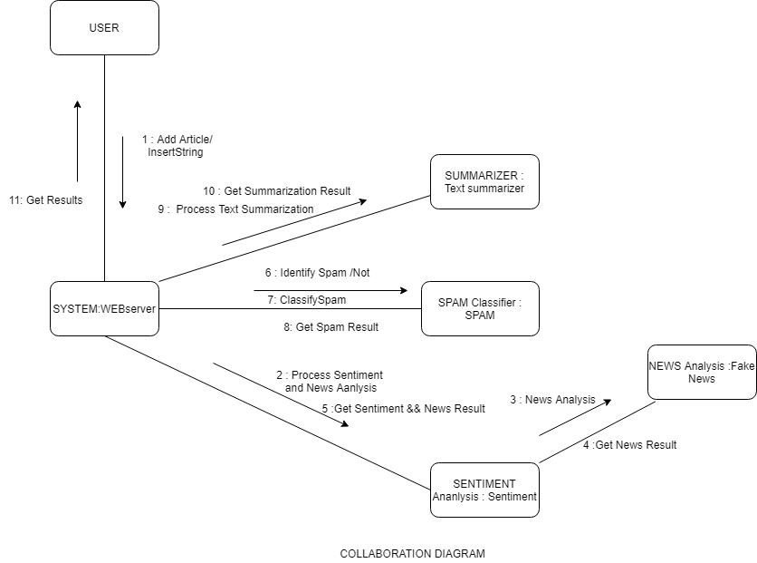
Collaboration Diagram

Slide 8
Test plans
S. No. | Parameter | Description
1. | Introduction | Fake news detection and sentiment analysis is a web based application that predicts the information or news is fake or genuine and also analyze the sentiment of information is positive, negative or neutral and also help in finding spam classification and summary of the information.
2. | Features to be tested | The feature that needs to be tested are fake news detection and sentiment Analysis of information or news.
3. | Test schedule | It includes some variety of the phases. For ex. Requirement understanding, test plan creation, test cases, test execution in different environments. Firstly, team understands the requirements for implementation of the projects. Then create the schedule for every phase or functionality. Then test the every functionality of system that means buttons in application, output result or recommendation and then make test cases for the test results. After the test cases system will check on every platform or device for the environment testing. If all testing will complete successfully then system will ready for run and then we stop testing.
4. | Environmental testing | We need some environmental requirements such as hardware, software, OS, network configurations, tools required that are system should have at least 4gb RAM, 500gb hard disk, windows 7,8,10 and 2mbps network connection.
5. | Open risk/issue | In implementation we face some issues that are data accuracy, calculations. Some functionality which are left to implement and testing. System have also some bugs and error which we will resolve soon.
6. | Exit criteria | When system has no bug/error and all functionality work properly and also system run on every platform then we will stop testing and system will ready for run.

Slide 9
Test Cases
S.No. | Title | Input | Action | Expected Output | Actual Output | Status | Remark
1. | Verify whether application launched on local system or not. | Enter run commands | Open application on the local system. | Application should run on local system browser. | Application successfully run on local system | Pass
2. | Verify that the application’s display is adapted to the screen and all the buttons and menus work properly. |  | Open application in browser and check screen size and buttons. | Application display should adaptable in screen size and all buttons and menu work properly. | Application display is adaptable in screen size and all buttons and menu work properly. | Pass
3. | Verify user able to enter information or news. | Click on text area. | Enter some information or news link. | Application allows to enter the information or news. | Application allow to enter the information or news successfully. | Pass
4. | Check application able to process or show result on the screen. | Click on proceed. | Enter some information or news link and proceed further. | Application shows the result on the screen. | Application shows the result on the screen successfully. | Pass
4. | Check application able to process or show result on the screen. | Click on proceed. | Enter some information or news link and proceed further. | Application shows the result on the screen. | Application shows the result on the screen successfully. | Pass
5. | Check application provides result that news or information is fake or genuine. | Click on proceed. | Enter some information or news link and proceed further. | Application shows the result that information or news is fake or genuine. | Application provides the result that information or news is fake or genuine successfully. | Pass
6. | Check application provides result which shows sentiment of the news or information i.e. positive, negative or neutral. | Click on proceed. | Enter some information or news link and proceed further. | Application shows the result that information or news is either positive, negative and neutral. | Application provides the result that information or news is either positive, negative and neutral successfully. | Pass

Slide 10
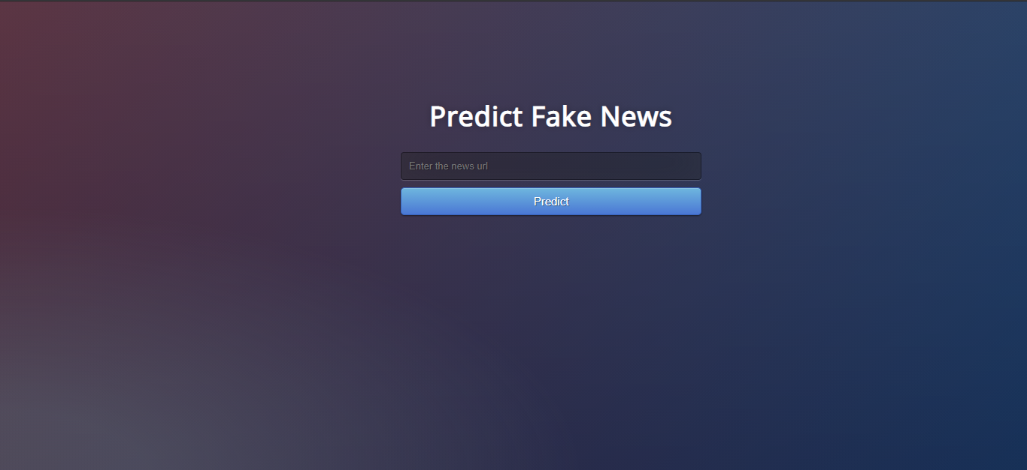
50 % implementation

Slide 11
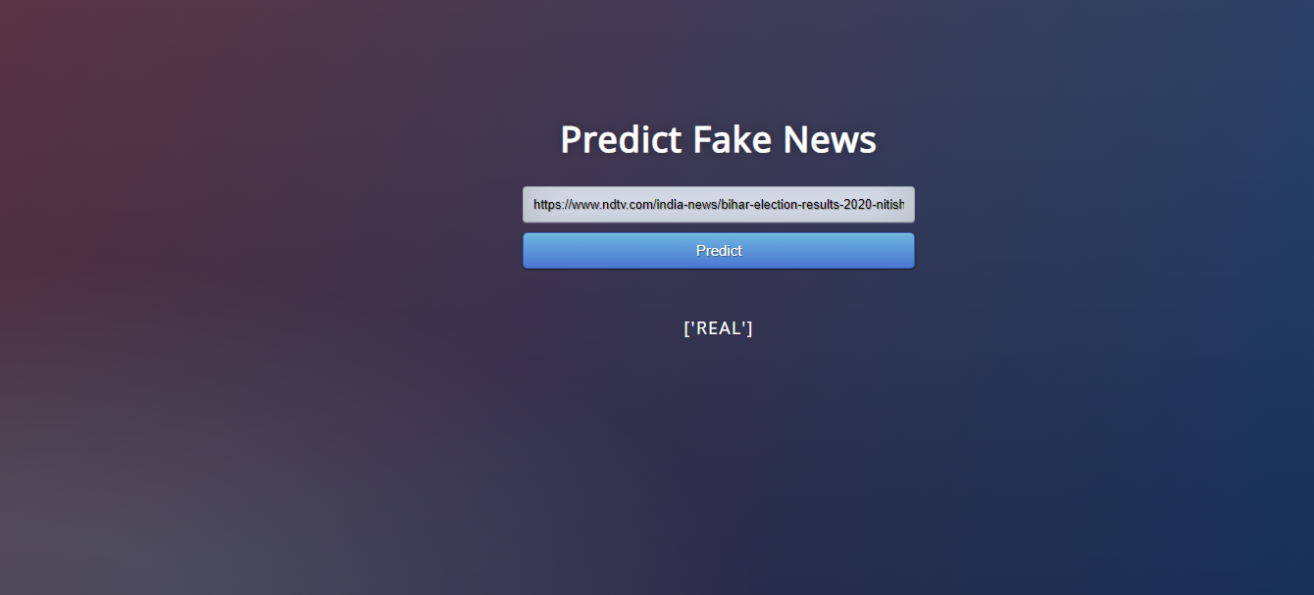

Slide 12


